Slide 1
Web Mining

Slide 2
Web mining
Web mining is an application of data mining techniques to find information patterns from the web data. Web mining helps to improve the power of web search engine by identifying the web pages and classifying the web documents.
web data contains different kinds of information including web documents data, web structure data and web log data
Web mining is very useful to e-commerce websites and e-services.

Slide 3
Types of web mining:
According to the kinds of data to be mined, Web Mining can be broadly divided into three categories:
1. Web Content Mining
2. Web Usage Mining
3. Web Structure Mining

Slide 4
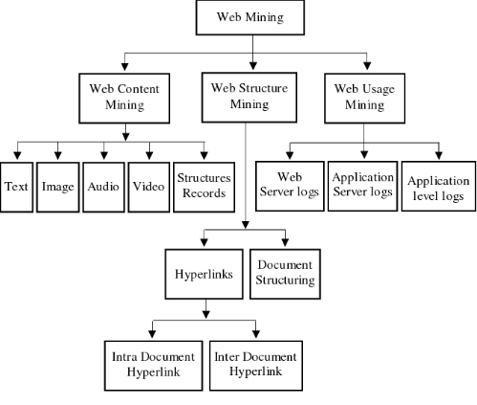
Web mining categories

Slide 5
Types of web mining: Web Content Mining
Web content mining is the application of extracting useful information from the content of the web documents.
The Web document usually contains several types of data, such as text, image, audio, video, metadata and hyperlinks.
Some of them are semistructured such as HTML documents or a more structured data like the data in the tables or database generated HTML pages, but most of the data is unstructured text data.

Slide 6
Types of web mining: Web Content Mining
Web content mining performs scanning and mining of the text, images and groups of web pages according to the content of the input (query), by displaying the list in search engines.
For example: If an user wants to search for a particular book, then search engine provides the list of suggestions.

Slide 7
Types of web mining: Web Usage Mining
Web usage mining is the application of identifying or discovering interesting usage patterns from large data sets.
And these patterns enable you to understand the user behaviors or something like that.
Web usage mining is used for mining the web log records (access information of web pages) and helps to discover the user access patterns of web pages.
Web server registers a web log entry for every web page.
Analysis of similarities in web log records can be useful to identify the potential customers for e-commerce companies.
In web usage mining, user access data on the web and collect data in form of logs. So, Web usage mining is also called log mining.

Slide 8
Types of web mining: Web Usage Mining
Some of the techniques to discover and analyze the web usage pattern are: i) Session and visitor analysis
The analysis of preprocessed data can be performed in session analysis ,which includes the record of visitors, days, sessions etc. This information can be used to analyze the behavior of visitors.
Report is generated after this analysis, which contains the details of frequently visited web pages, common entry and exit.
ii) OLAP (Online Analytical Processing)
OLAP performs Multidimensional analysis of complex data.
OLAP can be performed on different parts of log related data in a certain interval of time.
The OLAP tool can be used to derive the important business intelligence metrics.

Slide 9
Types of web mining: Web Structure Mining
Web Structure Mining is the process of discovering structure information from the Web.
It describes the connectivity in the Web subset based on the given collection of interconnected Web documents.
The structure of a typical Web graph consists of Web pages as nodes, and hyperlinks as edges connecting related pages.
The kind of structure information used in web structure mining are
Hyperlinks
Document structure

Slide 10
Types of web mining: Web Structure Mining
A Hyperlink is a structural unit that connects a location in a Web page to different location, either within the same Web page or on a different Web page.
A hyperlink that connects to a different part of the same page is called an Intra-Document Hyperlink, and a hyperlink that connects two different pages is called an Inter-Document Hyperlink.
There are a number of algorithms proposed based on the link analysis. Three important algorithms are PageRank , Weighted PageRank (WPR) and Hypertext Induced Topic Search

Slide 11
Types of web mining: Web Structure Mining
Document structure
A tree structured format can be used to organize the content with in a web page based on the various HTML and XML tags with in the page
Mining the structure and Web page structure, can be used to guide the classification and clustering of pages to find authoritative pages to improve retrieval performance
Example: Web structure mining can be very useful to companies to determine the connection between two commercial websites.

Slide 12
Link analysis algorithms(Web structure mining Techniques)
Web structure mining technique provides the additional information through hyperlinks where different documents are connected.
We can view the web as a directed labeled graph whose nodes are the documents or pages and edges are the hyperlinks between them .
This directed graph structure is known as web graph.
There are number of algorithms proposed based on link analysis. They are
PageRank
Weighted PageRank
HITS -Hyperlink-Induced Topic Search

Slide 13
PageRank (PR)
PageRank (PR) is an algorithm used by Google Search to rank web pages in their search engine results.
PageRank was named after Larry Page one of the founders of Google.
PageRank is a way of measurin g the importance of website pages.
PageRank works by counting the number and quality of links to a page to determine a rough estimate of how important the website is.
The underlying assumption is that more important websites are likely to receive more links from other websites.
Currently, PageRank is not the only algorithm used by Google to order search results, but it is the first algorithm that was used by the company, and it is the best known

Slide 14
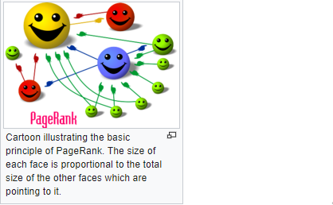

Slide 15
PageRank (PR)
This method provides a better approach that can compute the importance of web page by simply counting the number of pages that are linking to it.
These links are called as backlinks.
If a backlink comes from an important page then this link is given higher weightage than those which are coming from nonimportant pages.
The link from one page to another is considered as a vote.

Slide 16
PageRank (PR)
F ormula to calculate the PageRank of a page A as stated below
PR(A)= (1-d)+d(PR(T1)/C(T1)+…..+PR(Tn/C(Tn)) .....(1)
Here PR(Ti) is the PageRank of the Pages Ti which links to page A
C(Ti) is number of outlinks on page Ti and
d is damping factor.
It is used to stop other pages having too much influence.
The total vote is “damped down” by multiplying it to 0.85

Slide 17
Weighted PageRank
It is an extension of PageRank algorithm called as Weighted PageRank (WPR)
The functioning and basis of this new algorithm is same as that of PageRank algorithm but the rank score depends on the importance of each web page.
This algorithm assigns a larger rank score to the more important pages rather than dividing the rank score of a page equally among its outgoing linked pages .

Slide 18
Weighted PageRank
Advantages:
Quality: Quality of the pages returned by this algorithm is high as compared to pageRank algorithm.
Efficiency: It is more efficient than pageRank because rank value of a page is divided among it’s outlink pages according to importance of that page.
Disadvantages:
Less Relevant: As this algorithm considers only link structure not the content of the page, it returns less relevant pages to the user query.

Slide 19
HITS
HITS stands for Hypertext Induced Topics Search.
It is developed by Jon Kleinberg .
It is a link Analysis Algorithm that rates web pages.
In this search the web pages are divided into two types of pages.
They are Hubs and Authorities pages.
Hubs are pages that act as a resource list, containing a good source of links.
Authorities are pages that have a good source of content.
A web page can be both a hub as well as an authority.

Slide 20
The HITS algorithm considers the World Wide Web as a directed graph G(V,E) where V is a set of vertices depicting webpages and E is set of edges corresponding to the hyperlinks linking the different webpages
This algorithm assigns two scores for each page its authority, which estimates the value of the content of the page, and its hub value, which estimates the value of its links to other pages

Slide 21
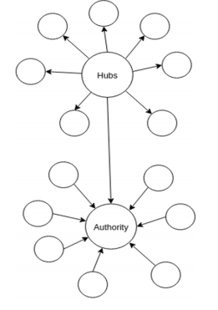
Hubs and Authority

Slide 22
Hits -steps
It has two steps:
1. Sampling Step:- In this step a set of relevant pages for the given query are collected.
2. Iterative Step:- In this step Hubs and Authorities are found using the output of sampling step.

Slide 23
HITS -Algorithm
Start with each node having a hub score and authority score of 1.
Run the authority update rule
Run the hub update rule
Normalize the values by dividing each Hub score by square root of the sum of the squares of all Hub scores, and dividing each Authority score by square root of the sum of the squares of all Authority scores.
Repeat from the second step as necessary.

Slide 24
Applications of Web Mining
With the rapid growth of World Wide Web, Web mining becomes a very hot and popular topic in Web research.
A few applications are:
Web mining helps to improve the power of web search engine by classifying the web documents and identifying the web pages.
It is used for Web Searching e.g., Google, Yahoo etc and Vertical Searching e.g., FatLens, Become etc.
Web mining is used to predict user behavior.
Web mining is very useful of a particular Website and e-service e.g., landing page optimization.

